Slide 1
Computer Vision
Fall 2017
Problem Set #5
Zhi Zhang
zhizhang@gatech.edu
Computer Vision @ GT

Slide 2
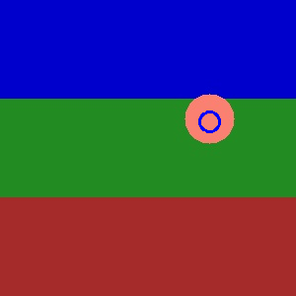
1b: KF Tracking a circle
ps5-1-b-1.png
Computer Vision @ GT

Slide 3
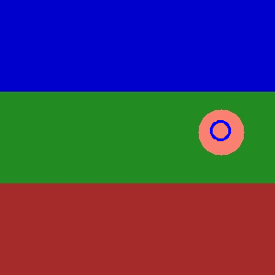
1b: KF Tracking a circle (cont.)
ps5-1-b-2.png
Computer Vision @ GT

Slide 4
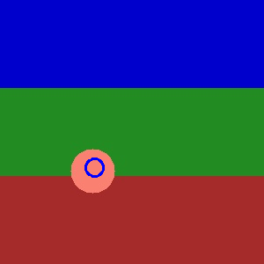
1b: KF Tracking a circle (cont.)
ps5-1-b-3.png
Computer Vision @ GT

Slide 5
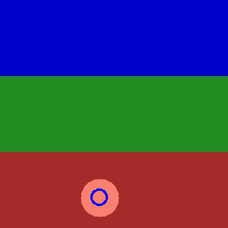
1b: KF Tracking a circle (cont.)
ps5-1-b-4.png
Computer Vision @ GT

Slide 6
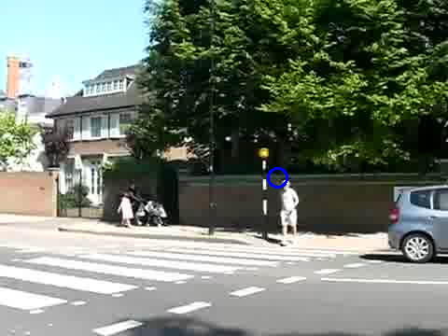
1c: KF Tracking pedestrians
ps5-1-c-1.png
Computer Vision @ GT

Slide 7
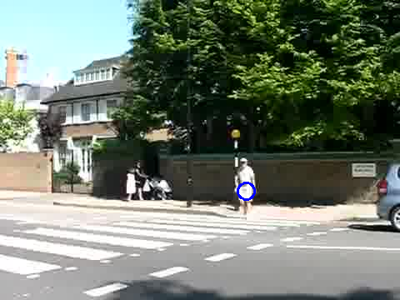
1c: KF Tracking pedestrians
ps5-1-c-2.png
Computer Vision @ GT

Slide 8
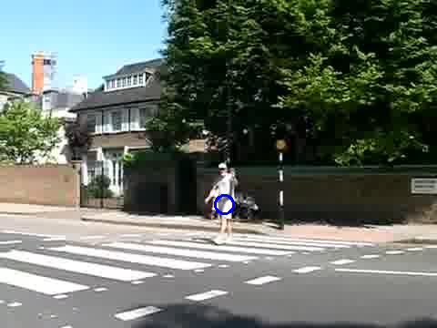
1c: KF Tracking pedestrians
ps5-1-c-3.png
Computer Vision @ GT

Slide 9
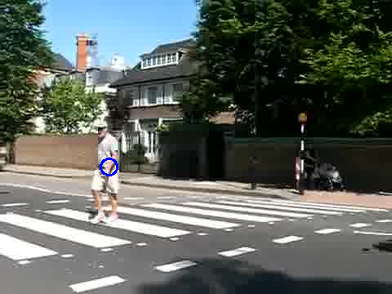
1c: KF Tracking pedestrians
ps5-1-c-4.png
Computer Vision @ GT

Slide 10
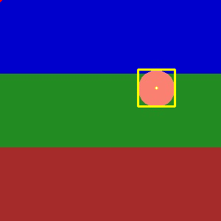
2a: PF Tracking a circle
ps5-2-a-1.png
Computer Vision @ GT

Slide 11
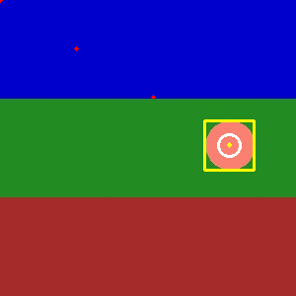
2a: PF Tracking a circle (cont.)
ps5-2-a-2.png
Computer Vision @ GT

Slide 12
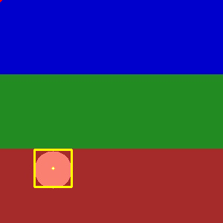
2a: PF Tracking a circle (cont.)
ps5-2-a-3.png
Computer Vision @ GT

Slide 13
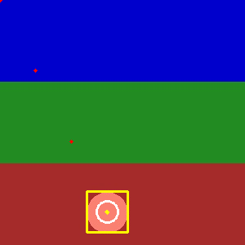
2a: PF Tracking a circle (cont.)
ps5-2-a-4.png
Computer Vision @ GT

Slide 14
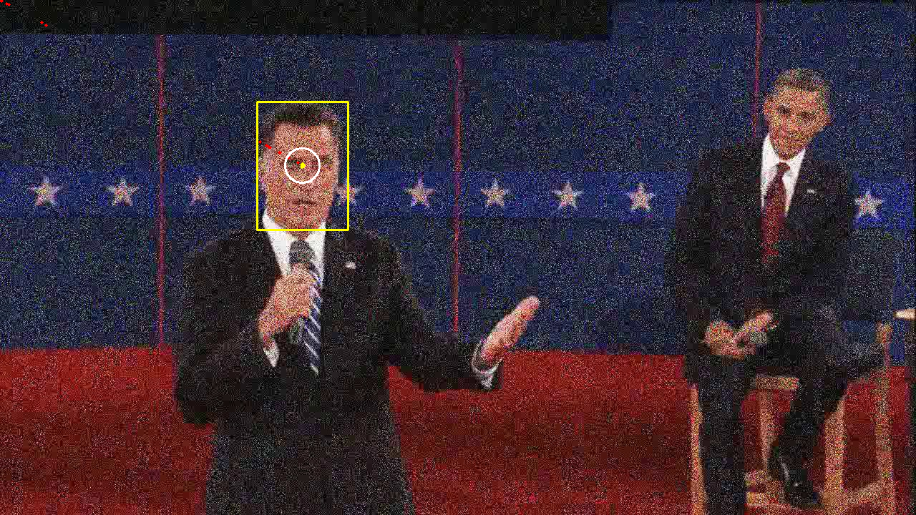
2b: PF Tracking noisy video
ps5-2-b-1.png
Computer Vision @ GT

Slide 15
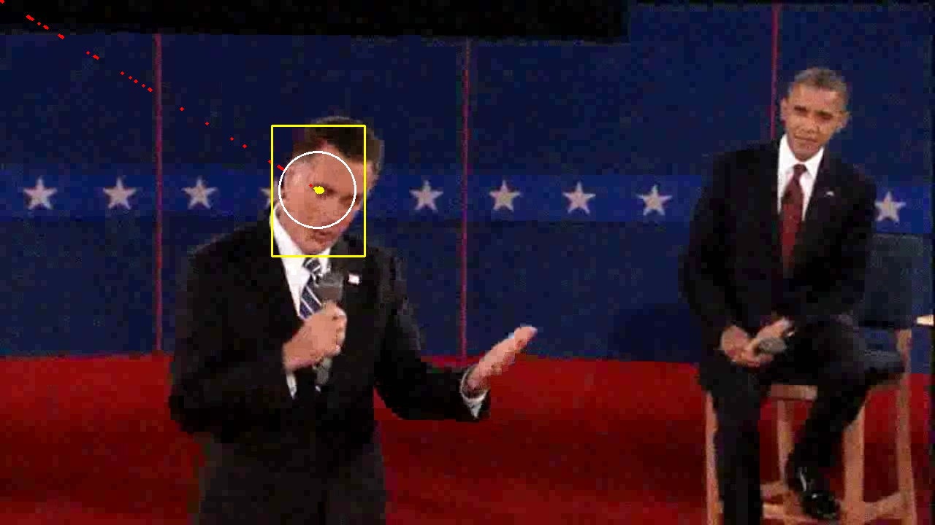
2b: PF Tracking noisy video (cont.)
ps5-2-b-2.png
Computer Vision @ GT

Slide 16
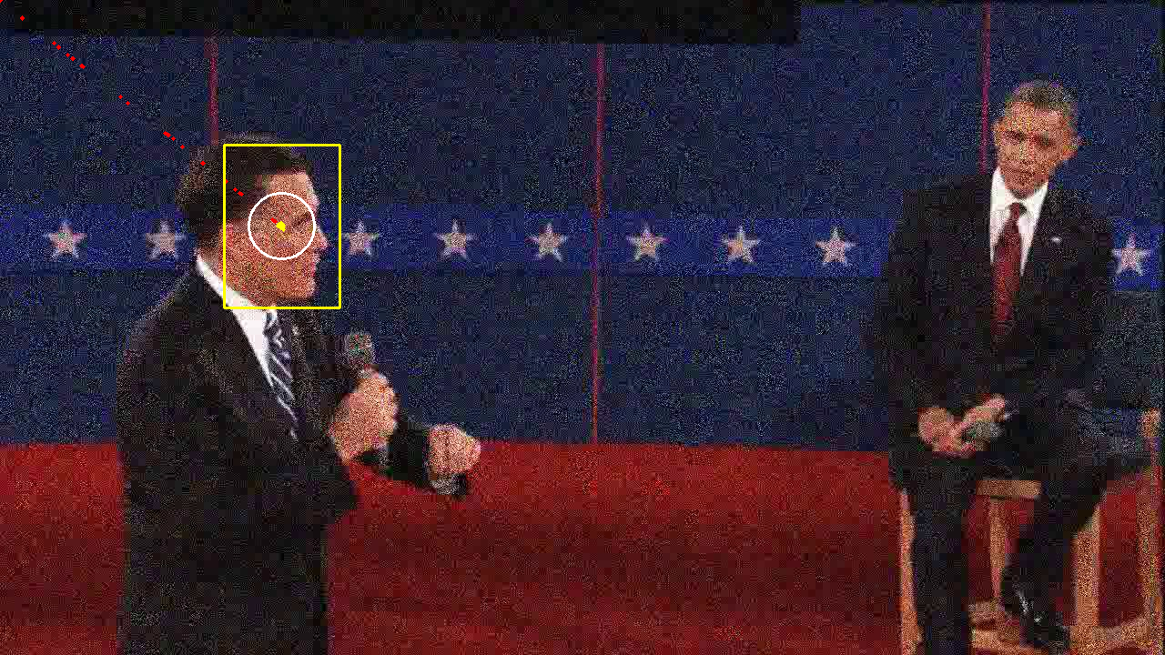
2b: PF Tracking noisy video (cont.)
ps5-2-b-3.png
Computer Vision @ GT

Slide 17
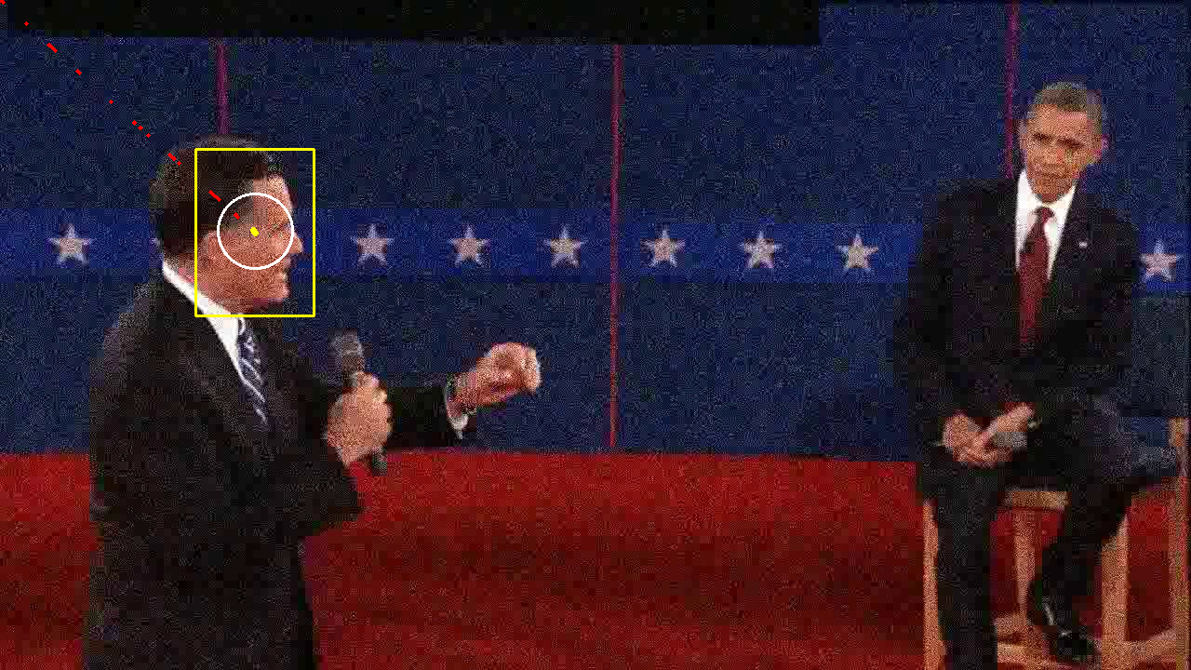
2b: PF Tracking noisy video (cont.)
ps5-2-b-4.png
Computer Vision @ GT

Slide 18
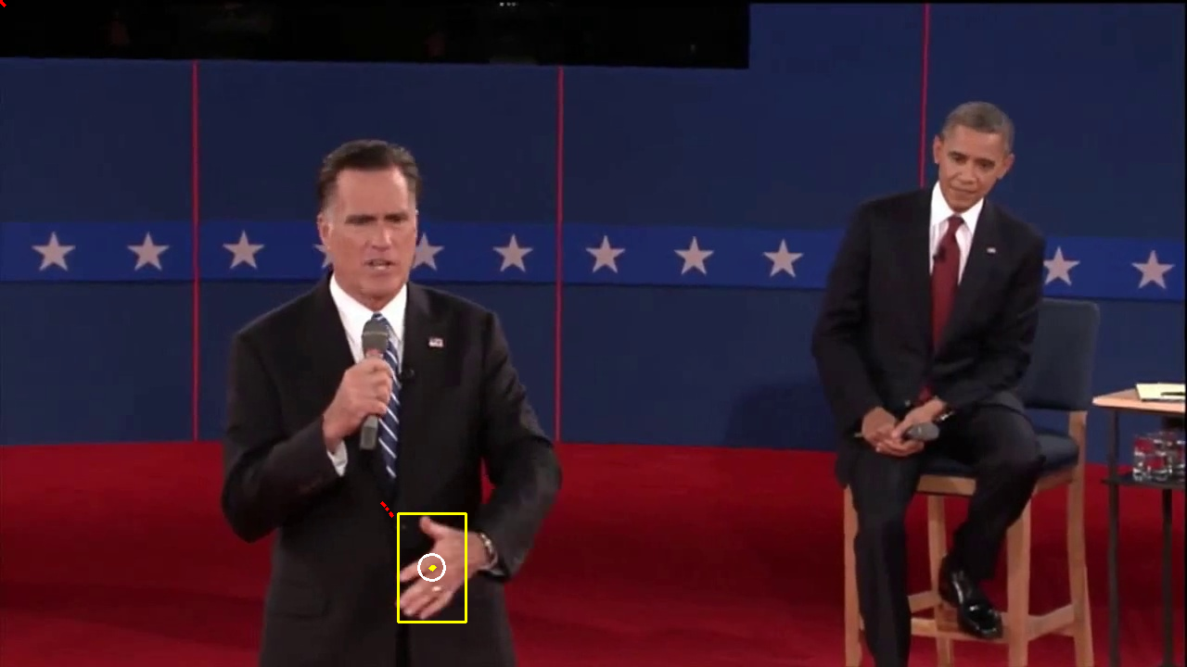
3a: PF Changes in Appearance
ps5-3-a-1.png
Computer Vision @ GT

Slide 19
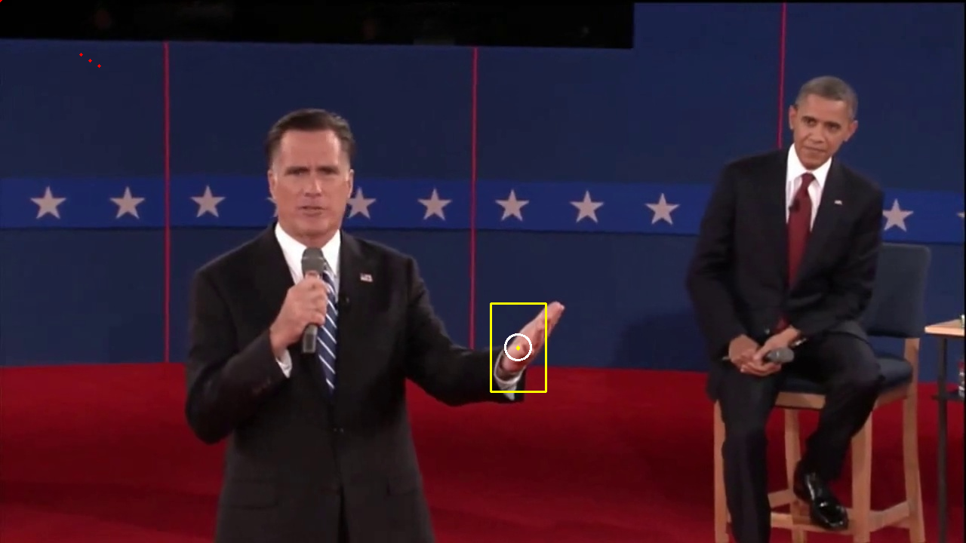
3a: PF Changes in Appearance (cont.)
ps5-3-a-2.png
Computer Vision @ GT

Slide 20
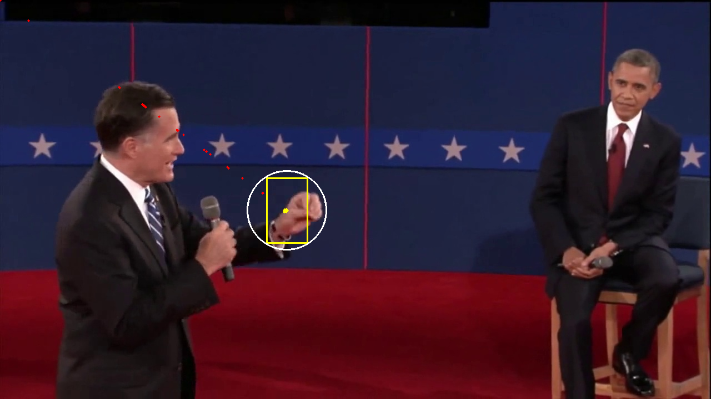
3a: PF Changes in Appearance (cont.)
ps5-3-a-3.png
Computer Vision @ GT

Slide 21
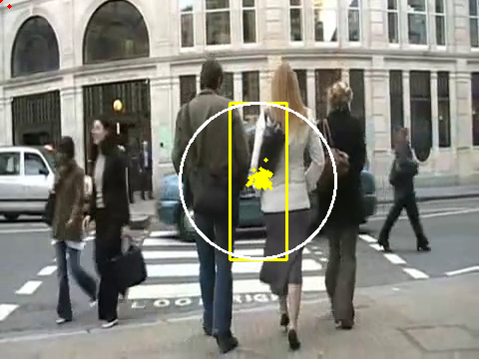
4a: PF Occlusions
ps5-4-a-1.png
Computer Vision @ GT

Slide 22
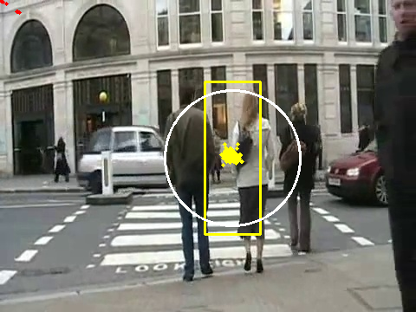
4a: PF Occlusions (cont.)
ps5-4-a-2.png
Computer Vision @ GT

Slide 23
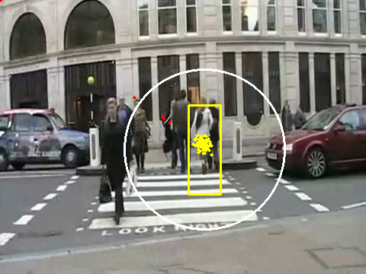
4a: PF Occlusions (cont.)
ps5-4-a-3.png
Computer Vision @ GT

Slide 24
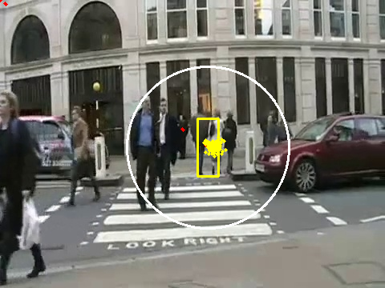
4a: PF Occlusions (cont.)
ps5-4-a-4.png
Computer Vision @ GT

Slide 25
4: Text response
Describe what you did. How did you modify the Particle Filter class to continue tracking after occlusions?
What I did is adding a third dimension scale factor (0 – 1) to the particles, so this scale factor will be used to resize the template and proposed template for every particle then calculating the probability, and just like the (x, y), the scale factor for the most weighted particles will be similar after resample the particles. I also perturbed the scale factor with a small Gaussian noise, so this noise will be applied on the dynamics model allowing the scale factor become smaller and smaller. About the occlusions, I had done something basically to output every frame’s average or median MSE and use it to decide a threshold value, if the current MSE is bigger than that threshold, then I will skip resample the particle, and if it’s smaller than it, then I will go back to normal process.
Computer Vision @ GT

Slide 26
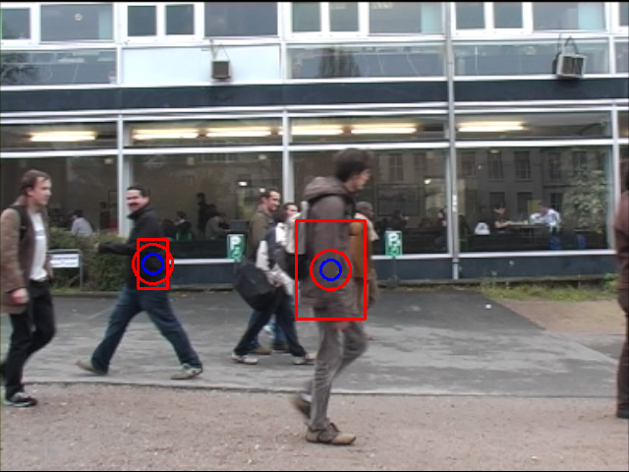
5: Tracking multiple targets
ps5-5-a-1.png
Computer Vision @ GT

Slide 27
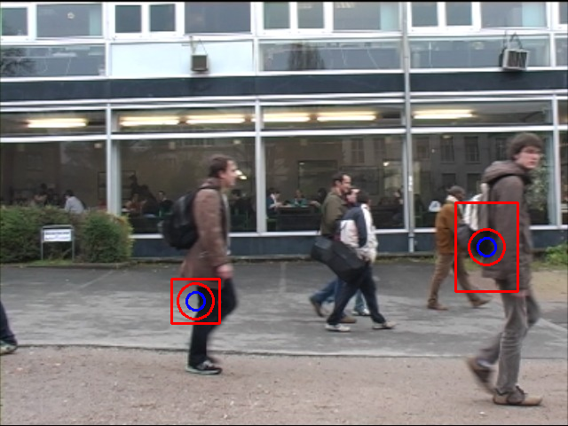
5: Tracking multiple targets (cont.)
ps5-5-a-2.png
Computer Vision @ GT

Slide 28
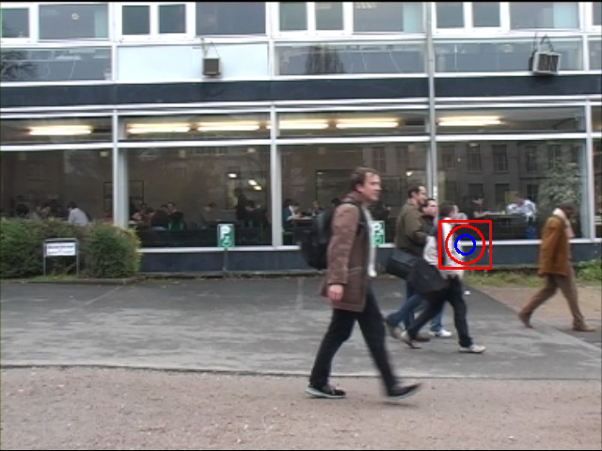
5: Tracking multiple targets (cont.)
ps5-5-a-3.png
Computer Vision @ GT

Slide 29
5: Text response
Describe what you did. How different it was to use a KF vs PF? Which one worked best and why? Include details about any modifications you had to apply to handle multiple targets.
Based on my results, the KF works better, the PF seems not work very well, no matter I tried all the tricks I used before. As for KF, I adjusted the noise, and also controlled what frame number expected for that person. KF is more like a linear dynamical models with Gaussian noise, which is often optimal to track multiple targets in a relative simple situation, but particle filter is more like a sequential dynamic approach, which is more general and good for complex situations.
Computer Vision @ GT

Slide 30
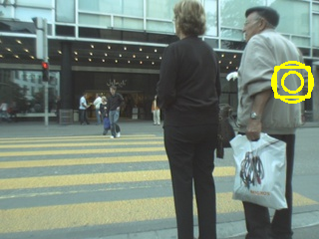
6: Challenge Problem
ps5-6-a-1.png
Computer Vision @ GT

Slide 31
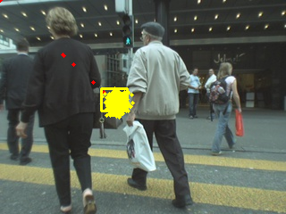
6: Challenge Problem (cont.)
ps5-6-a-2.png
Computer Vision @ GT

Slide 32
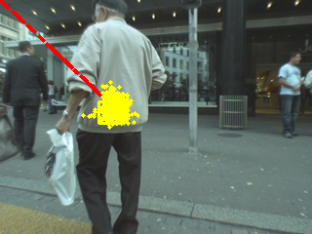
6: Challenge Problem (cont.)
ps5-6-a-3.png
Computer Vision @ GT

Slide 33
6: Challenge Problem Text response
Text Answer: Describe what you did. Did this task present any additional challenges compared to the previous sections? Include details about any modifications you had to apply.
I combined the KF and PF, because KF is good at beginning when the target moving towards the right, but PF is more adapted the situation the camera zoomed in and out, I also adjusted the noise sigma and created threshold to cutoff the particles that fall too far out of predicated value.
Computer Vision @ GT

